Slide 1


Dhara Dhruva
28/7/2025

Slide 2

Outline
Executive Summary
Introduction
Methodology
Results
Conclusion
Appendix

Slide 3
Executive Summary
Summary of methodologies
Data collection via API
Data collection with Web Scraping
Data wrangling o Exploratory Data Analysis with SQL
Interactive Visual Analytics with Folium
Interactive Dashboard with Plotly Dash
Machine Learning Prediction
Summary of all results
Success Rate over Time: An improvement in success rate was observed over time.
Success Rate by Launch Site: KSC LC-40A shows the highest success rate of all launch sites.
Payload: Heavier payloads have a high failure rate early on with a significant improvement over time.

Slide 4
Introduction
SpaceX advertises Falcon 9 rocket launches on its website with a cost of 62 million dollars; other providers cost upwards of 165 million dollars each, much of the savings is because
SpaceX can reuse the first stage. Therefore, if we can determine if the first stage will land, we can determine the cost of a launch.
This information can be used if an alternate company wants to bid against SpaceX for a rocket launch.
In this lab, you will collect and make sure the data is in the correct format from an API.
Space X performs a controlled landing in the oceans.

Slide 5

Section 1

Slide 6
Methodology
Executive Summary
Data collection methodology:
Request and parse the SpaceX launch data using the GET request
Filter the dataframe to only include Falcon 9 Launches
Perform data wrangling
some of the rows are missing values in our dataset.
Before we can continue we must deal with these missing values. The LandngPad column will retain None values to represent when landing pads were not used.
We can now export it to a CSV for the next section, but to make the answers consistent, in the next lab we will provide data in a pre-selected date range.
Perform exploratory data analysis (EDA) using visualization and SQL
Visualize Variable Relationship
Look at the data in aggregagate
Perform interactive visual analytics using Folium and Plotly Dash
Mark all launch sites on a map
Mark successful and failed launches
Calculate distances to proximate locations
Provide for interactive exploration of the data
Perform predictive analysis using classification models
Build, evaluate, and compare several predictive classification models

Slide 7
Data Collection
Data sets were collected. from
HTTP requests against various SpaceX API endpoints:
Initial launch data was obtained from: /v4/launches/past
Additional data was backfilled from:
/v4/Rocket, Launchpad, pockets, cores

Slide 8
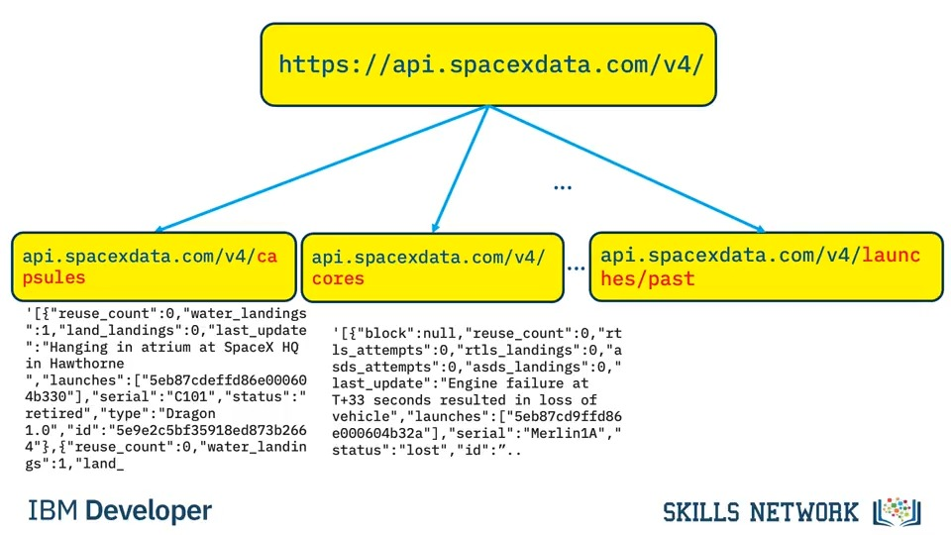
Data Collection – SpaceX API
Present your data collection with SpaceX REST calls using key phrases and flowcharts
https://github.com/Dhara311/UseDataScienceTools/blob/main/jupyter-labs-spacex-data-collection-api.ipynb

Slide 9
Data Collection - Scraping
Present your web scraping process using key phrases and flowcharts
https://github.com/Dhara311/UseDataScienceTools/blob/main/jupyter-labs-webscraping.ipynb
Place your flowchart of web scraping here

Slide 10
Data Wrangling
Goals: Use Exploratory Data Analysis (EDA) to find patterns in the data.
Determine the labels for training supervised models.
Find missing values as a percentage of each attribute
Identify column types, numerical or categorical
Show launches per Launch Site
Show distribution of Orbit type in the data set
Explore outcomes, and group them by binary outcome (success or failure)
Store outcome as "Class" label, to be used as target value in training
https://github.com/Dhara311/UseDataScienceTools/blob/main/labs-jupyter-spacex-Data%20wrangling.ipynb

Slide 11
EDA with Data Visualization
Visualize relationships to gain insight into the importance of each variable:
Flight Number and Outcome
Flight Number and Launch Site
Payload and Launch Site
Orbit and Outcome
Flight Number and Orbit
Payload and Orbit
Yearly success rate
Expand categorical variables into "dummy" columns
Convert numerical columns into float64
https://github.com/Dhara311/UseDataScienceTools/blob/main/edadataviz.ipynb

Slide 12
EDA with SQL
• SQL Queries Performed:
Show each unique launch site
Show 5 records where launch site names begin with 'CCA’
Display the total payload mass carried by boosters launched by 'NASA (CRS)’
Display the average payload mass carried by the v1.1 Falcon 9 booster
List the date of the first successful ground landing outcome
List the booster versions with successful outcomes landing on the drone ship with payloads between 4000kg and 6000kg.
List the number of successful and failed mission outcomes
List all of the booster versions that carried the max payload mass
List the month name, outcome, booster version, and launch site for missions with failure outcomes landing on a drone ship in 2015.
Show the distribution of outcomes between June 4th, 2010 and March 20th, 2017
https://github.com/Dhara311/UseDataScienceTools/blob/main/jupyter-labs-eda-sql-coursera_sqllite.ipynb

Slide 13
Build an Interactive Map with Folium
To find geographical patterns in the data the following items were marked on a map of launch sites:
All Launch Sites
Successful and Failed Launches
Distances between a launch site and proximate landmarks
https://github.com/Dhara311/UseDataScienceTools/blob/main/lab_jupyter_launch_site_location.ipynb

Slide 14
Build a Dashboard with Plotly Dash
To enable interactive exploration of the data, a Plotly Dash dashboard was developed to include: o
A dropdown selector to choose a Launch Site, affecting:
A pie chart
All sites selected: shows the breakdown of successful outcomes across all sites
A launch site selected: shows the breakdown of successful vs failed launches for the given site
A scatter plot

Slide 15
Predictive Analysis (Classification)
Load data
Apply StandardizedScaler on X
Convert Y to numpy array
Split training and testing data
Use GridSearchCV to test hyperparameters for multiple algorithms:
Logistic Regression
SVC
Decision Tree Classifier
K Neighbors Classifier
https://github.com/Dhara311/UseDataScienceTools/blob/main/SpaceX_Machine%20Learning%20Prediction_Part_5.ipynb

Slide 16
Results
Exploratory data analysis results
Interactive analytics demo in screenshots
Predictive analysis results

Slide 17

Section 2

Slide 18
Flight Number vs. Launch Site
Show a scatter plot of Flight Number vs. Launch Site
Show the screenshot of the scatter plot with explanations

Slide 19
Payload vs. Launch Site
Show a scatter plot of Payload vs. Launch Site
Show the screenshot of the scatter plot with explanations

Slide 20
Success Rate vs. Orbit Type
Show a bar chart for the success rate of each orbit type
Show the screenshot of the scatter plot with explanations

Slide 21
Flight Number vs. Orbit Type
Show a scatter point of Flight number vs. Orbit type
Show the screenshot of the scatter plot with explanations

Slide 22
Payload vs. Orbit Type
Show a scatter point of payload vs. orbit type
Show the screenshot of the scatter plot with explanations

Slide 23
Launch Success Yearly Trend
Show a line chart of yearly average success rate
Show the screenshot of the scatter plot with explanations

Slide 24
All Launch Site Names
Find the names of the unique launch sites
Present your query result with a short explanation here

Slide 25
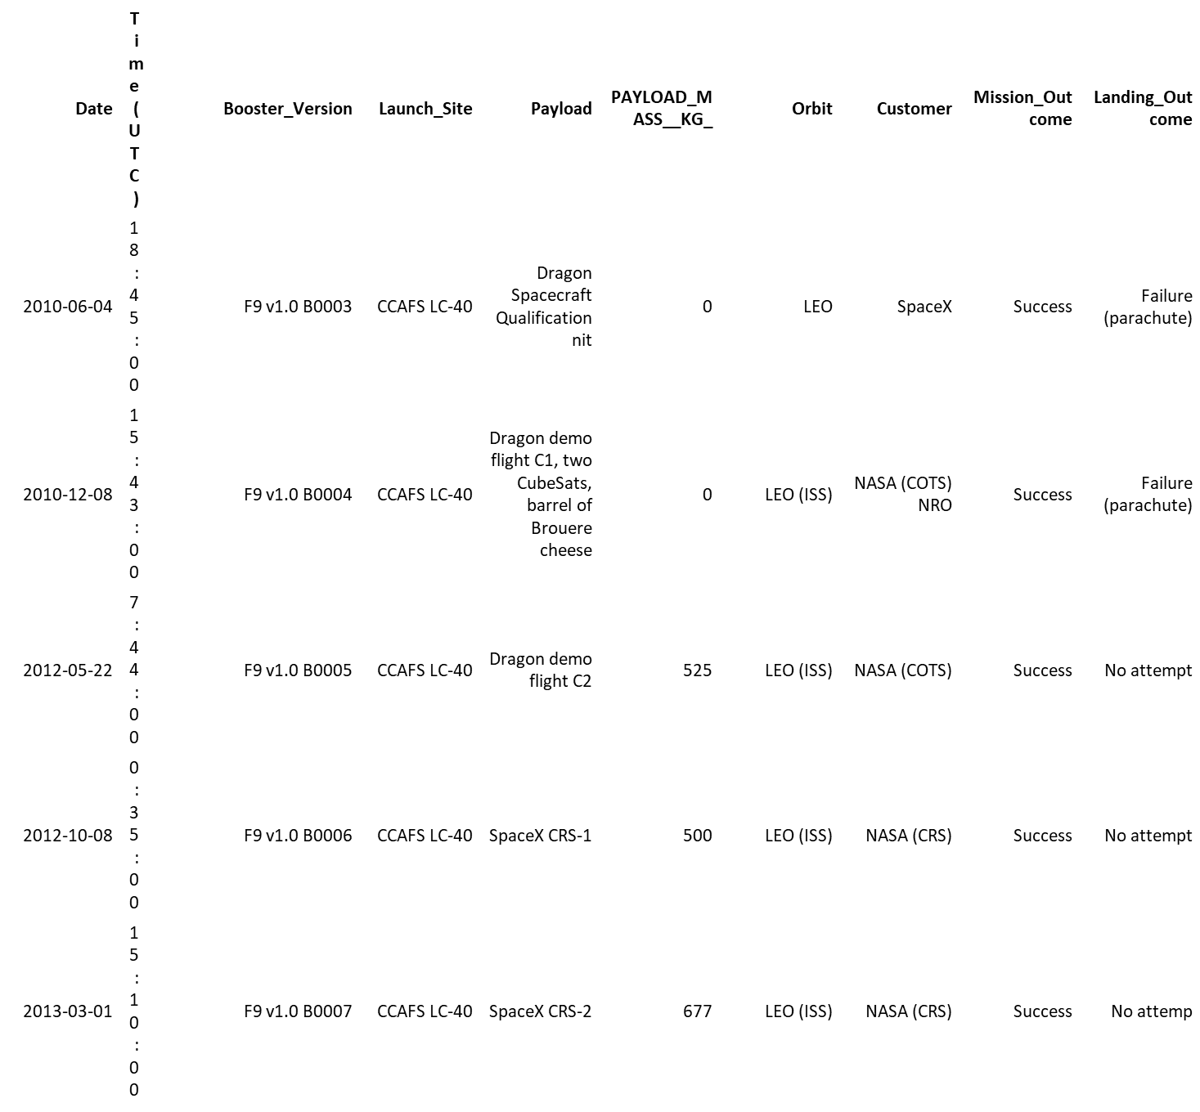
Launch Site Names Begin with 'CCA'
%%sqlSELECT * FROM SPACEXTABLE WHERE Launch_Site LIKE 'CCA%' LIMIT 5;

Slide 26
Total Payload Mass
%%sqlSELECT SUM(PAYLOAD_MASS__KG_) AS TOTAL_PAYLOAD FROM SPACEXTABLE WHERE Customer = 'NASA (CRS)’;
TOTAL_PAYLOAD
45596

Slide 27
Average Payload Mass by F9 v1.1
%%sqlSELECT AVG(PAYLOAD_MASS__KG_) AS AVG_PAYLOAD_MASS FROM SPACEXTABLE WHERE Booster_Version LIKE 'F9 v1.1%’;
AVG_PAYLOAD_MASS
2534.6666666666665

Slide 28
First Successful Ground Landing Date
%%sqlSELECT MIN(Date) as LaunchDate FROM SPACEXTABLE WHERE Landing_Outcome = 'Success (ground pad)’;
LaunchDate
2015-12-22

Slide 29
Successful Drone Ship Landing with Payload between 4000 and 6000
%%sqlSELECT Booster_Version, PAYLOAD_MASS__KG_ FROM SPACEXTABLE WHERE Landing_Outcome = 'Success (drone ship)' AND PAYLOAD_MASS__KG_ BETWEEN 4000 AND 6000;
Booster_Version | PAYLOAD_MASS__KG_
F9 FT B1022 | 4696
F9 FT B1026 | 4600
F9 FT B1021.2 | 5300
F9 FT B1031.2 | 5200

Slide 30
Total Number of Successful and Failure Mission Outcomes
%%sqlSELECT CASE WHEN Mission_Outcome LIKE 'Success%' THEN 'Success' WHEN Mission_Outcome LIKE 'Failure%' THEN 'Failure'END as Mission_Status,COUNT(*)FROM SPACEXTABLEGROUP BY Mission_Status;
Mission_Status | COUNT(*)
Failure | 1
Success | 100

Slide 31
Boosters Carried Maximum Payload
%%sqlSELECT DISTINCT Booster_Version, PAYLOAD_MASS__KG_ FROM SPACEXTABLE WHERE PAYLOAD_MASS__KG_ = (SELECT MAX(PAYLOAD_MASS__KG_) FROM SPACEXTABLE) ORDER BY Booster_Version;
Booster_Version | PAYLOAD_MASS__KG_
F9 B5 B1048.4 | 15600
F9 B5 B1048.5 | 15600
F9 B5 B1049.4 | 15600
F9 B5 B1049.5 | 15600
F9 B5 B1049.7 | 15600
F9 B5 B1051.3 | 15600
F9 B5 B1051.4 | 15600
F9 B5 B1051.6 | 15600
F9 B5 B1056.4 | 15600
F9 B5 B1058.3 | 15600
F9 B5 B1060.2 | 15600
F9 B5 B1060.3 | 15600

Slide 32
2015 Launch Records
%%sql SELECT CASE strftime('%m', Date) WHEN '01' THEN 'January' WHEN '02' THEN 'February' WHEN '03' THEN 'March' WHEN '04' THEN 'April' WHEN '05' THEN 'May' WHEN '06' THEN 'June' WHEN '07' THEN 'July' WHEN '08' THEN 'August' WHEN '09' THEN 'September' WHEN '10' THEN 'October' WHEN '11' THEN 'November' WHEN '12' THEN 'December' END as Month, Landing_Outcome, Booster_Version, Launch_Site, DateFROM SPACEXTABLEWHERE strftime('%Y', Date) = '2015' AND Landing_Outcome = 'Failure (drone ship)';
Month | Landing_Outcome | Booster_Version | Launch_Site | Date
January | Failure (drone ship) | F9 v1.1 B1012 | CCAFS LC-40 | 2015-01-10
April | Failure (drone ship) | F9 v1.1 B1015 | CCAFS LC-40 | 2015-04-14

Slide 33
Rank Landing Outcomes Between 2010-06-04 and 2017-03-20
%%sqlSELECT Landing_Outcome, COUNT(*) as Count FROM SPACEXTABLE WHERE Date BETWEEN '2010-06-04' AND '2017-03-20' GROUP BY Landing_Outcome ORDER BY Count DESC;
Landing_Outcome | Count
No attempt | 10
Success (drone ship) | 5
Failure (drone ship) | 5
Success (ground pad) | 3
Controlled (ocean) | 3
Uncontrolled (ocean) | 2
Failure (parachute) | 2
Precluded (drone ship) | 1

Slide 34

Section 3

Slide 35
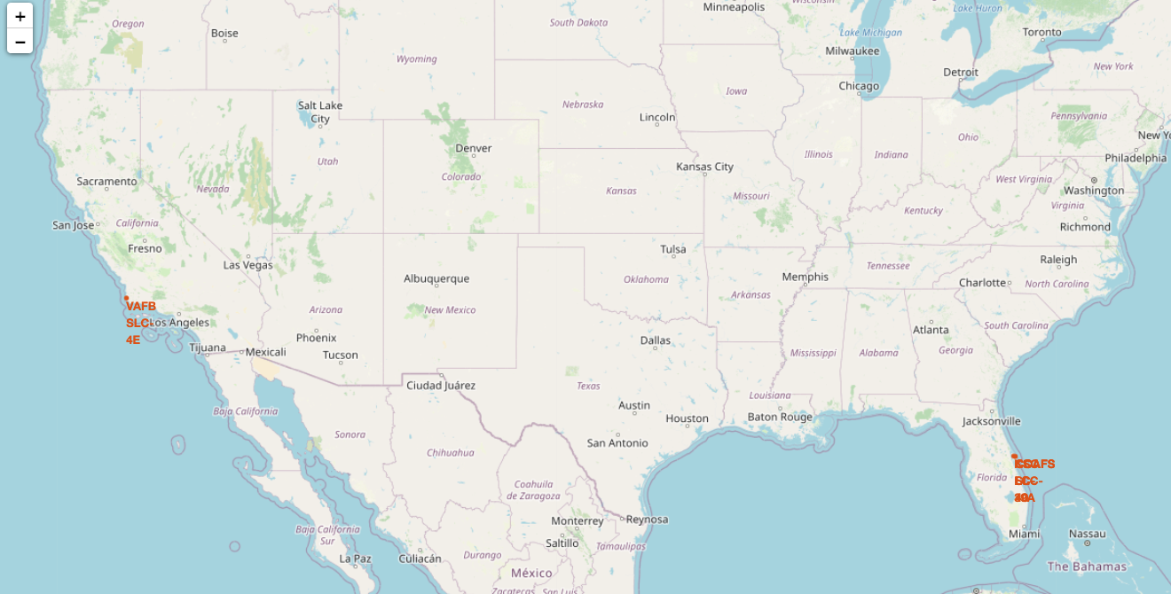
Launch Site Location

Slide 36
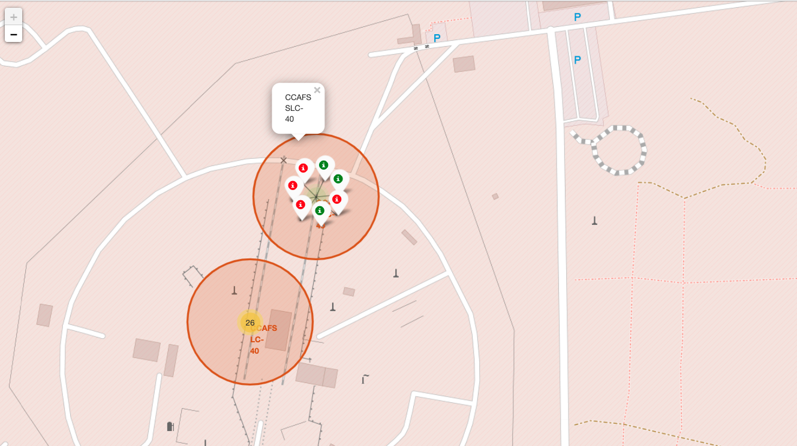
Launch Outcomes

Slide 37


